Slide 1
Excel Tutorial 5 Working with Excel Tables, PivotTables, and PivotCharts

Slide 2
Objectives
Explore a structured range of data
Freeze rows and columns
Plan and create an Excel table
Rename and format an Excel table
Add, edit, and delete records in an Excel table
Sort data
Filter data
Insert a Total row to summarize an Excel table

Slide 3
Objectives
Insert subtotals into a range of data
Use the Outline buttons to show or hide details
Create and modify a PivotTable
Apply PivotTable styles and formatting
Filter and sort a PivotTable
Group PivotTable items
Create a PivotChart

Slide 4
Planning a Structured Range of Data
One of the more common uses of a worksheet is to manage data
Using Excel, you can store and update data, sort data, search for and retrieve subsets of data, summarize data, and create reports. In Excel, a collection of similar data can be structured in a range of rows and columns
Each column in the range represents a field
Each row in the range represents a record

Slide 5
Freezing Rows and Columns
Freezing a row or column lets you keep headings visible as you work with the data in a large worksheet
To freeze a row or column, you select the cell immediately below the row(s) and to the right of the column(s) you want to freeze
Click the View tab on the Ribbon
In the Window group, click the Freeze Panes button

Slide 6
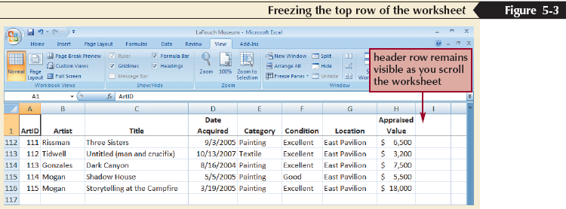
Freezing Rows and Columns

Slide 7
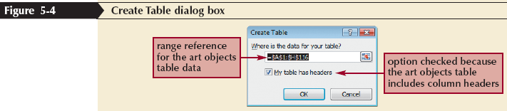
Creating an Excel Table
Click the Insert tab on the ribbon, and then click the Table button

Slide 8
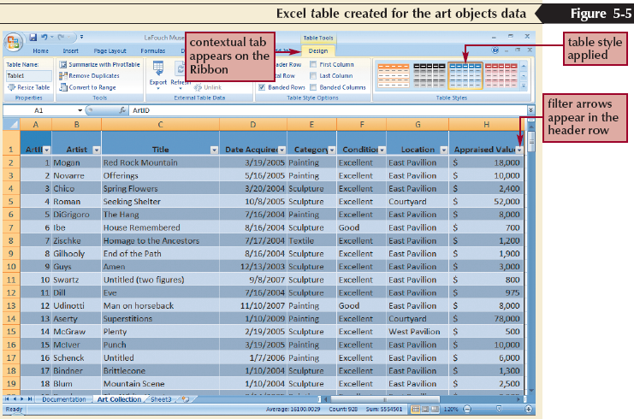
Creating an Excel Table

Slide 9
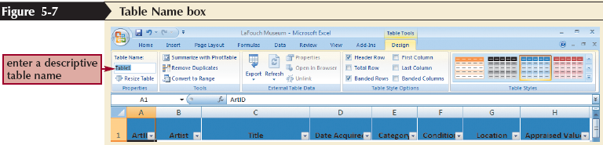
Renaming an Excel Table

Slide 10
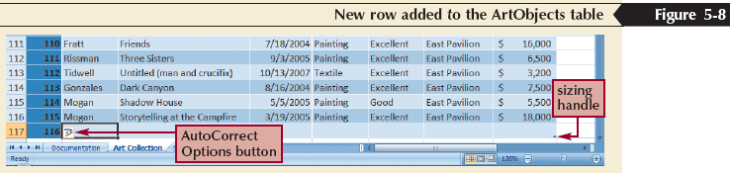
Adding a Record to an Excel Table
Click in the row below the last row of the Excel table
Type the values for the new record, pressing the Tab key to move from field to field
Press the Tab key to create another new record, or press the Enter key if this is the last record

Slide 11
Finding and Editing Records
In the Editing group on the Home tab, click the Find & Select button, and then click Find
Type your search criteria in the Find what box, and then click the Find & Select button

Slide 12
Sorting Data
You can rearrange, or sort, the records in a table or range based on the data in one or more fields
The fields you use to order the data are called sort fields
You can sort data in ascending or descending order

Slide 13
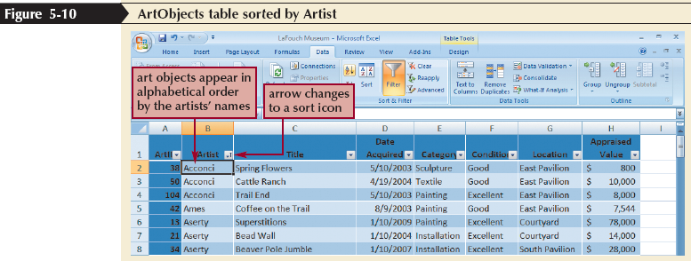
Sorting Data

Slide 14
Sorting Multiple Columns using the Sort Dialog Box
Click any cell in a table or range
In the Sort & Filter group on the Data tab, click the Sort button to open the Sort dialog box
If the Sort by row exists, modify the primary sort by selections; otherwise, click the Add Level button to insert the Sort by row
Click the Sort by arrow, select the column heading that you want to specify as the primary sort field, click the Sort On arrow to select the type of data, then click the Order arrow to select the sort order

Slide 15
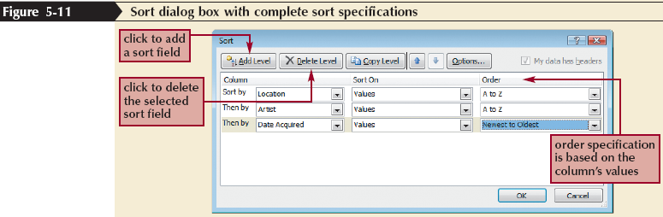
Sorting Multiple Columns using the Sort Dialog Box
To sort by a second column, click the Add Level button to add the first Then by row. Click the Sort by arrow, select the column heading that you want to specify as the secondary sort field, click the Sort On arrow to select the type of data, then click the Order arrow to select the sort order
To sort by additional columns, click the Add Level button and select appropriate Then by, Sort On, and Order values
Click the OK button

Slide 16
Sorting Using a Custom List
A custom list indicates the sequence in which you want data ordered
In the Sort & Filter group on the Data tab, click the Sort button
Click the Order arrow, and then click Custom List
In the List entries box, type each entry for the custom list, pressing the Enter key after each entry
Click the Add button
Click the OK button

Slide 17
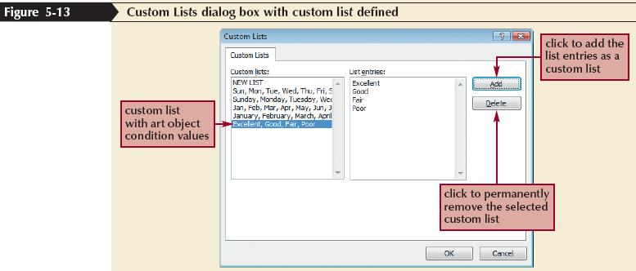
Sorting Using a Custom List

Slide 18
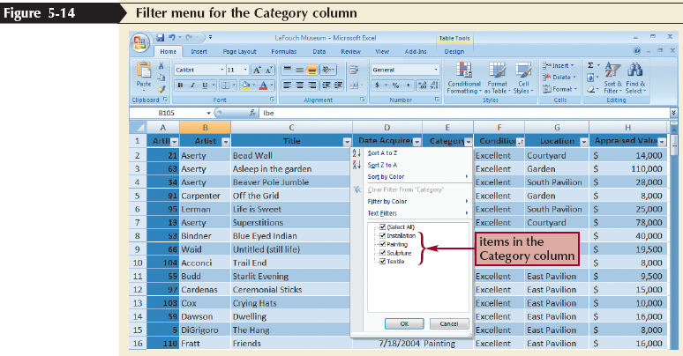
Filtering Using One Column

Slide 19
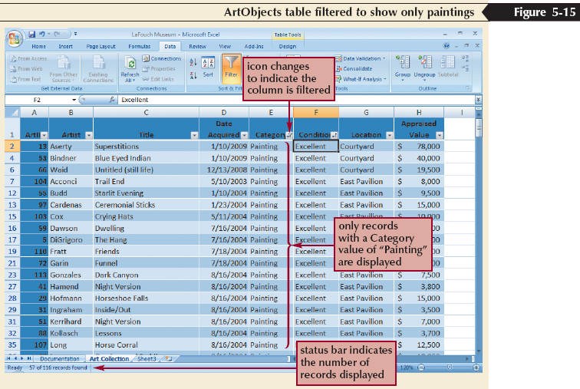
Filtering Using One Column

Slide 20
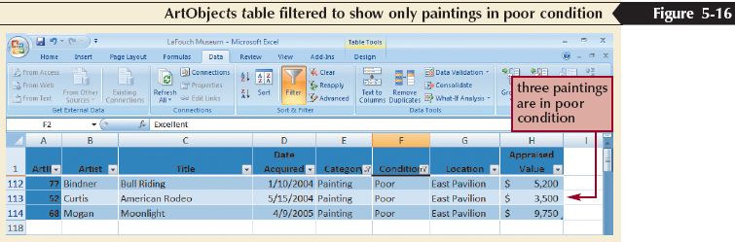
Filtering Using Multiple Columns
If you need to further restrict the records that appear in a filtered table, you can filter by one or more of the other columns
Each additional filter is applied to the currently filtered data and further reduces the records that are displayed

Slide 21
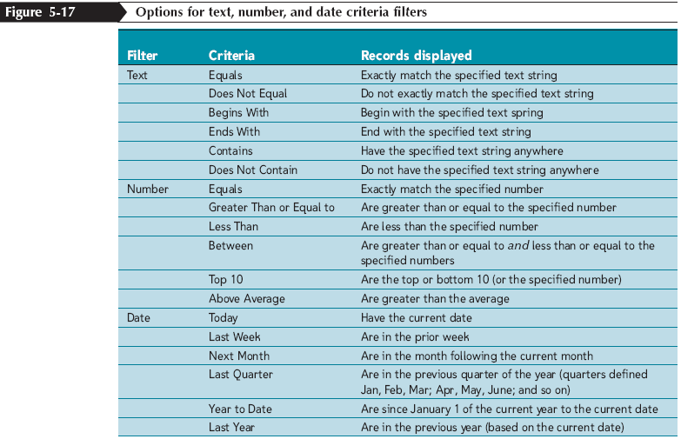
Creating Criteria Filters to Specify More Complex Criteria
Criteria filters enable you to specify various conditions in addition to those that are based on an “equals” criterion

Slide 22
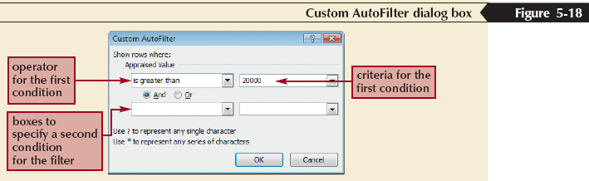
Creating Criteria Filters to Specify More Complex Criteria

Slide 23
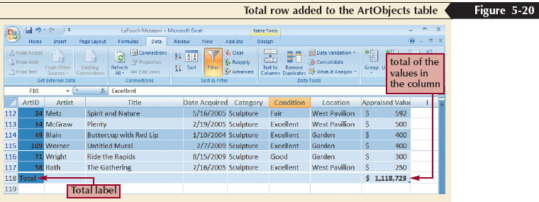
Using the Total Row to Calculate Summary Statistics
A Total row, which you can display at the end of the table, is used to calculate summary statistics for the columns in an Excel table
Click the Table Tools Design tab on the Ribbon, and then, in the Table Style Options group, click the Total Row check box to insert a check mark

Slide 24
Calculating Subtotals for a Range of Data
Sort the data by the column for which you want a subtotal
If the data is in an Excel table, in the Tools group on the Table Tools Design tab, click the Convert to Range button, and then click the Yes button to convert the Excel table to a range
In the Outline group on the Data tab, click the Subtotal button
Click the At each change in arrow, and then click the column that contains the group you want to subtotal

Slide 25
Calculating Subtotals for a Range of Data
Click the Use function arrow, and then click the function you want to use to summarize the data
In the Add subtotal to box, click the check box for each column that contains the values you want to summarize
To calculate another category of subtotals, click the Replace current subtotals check box to remove the check mark, and then repeat the previous three steps
Click the OK button

Slide 26
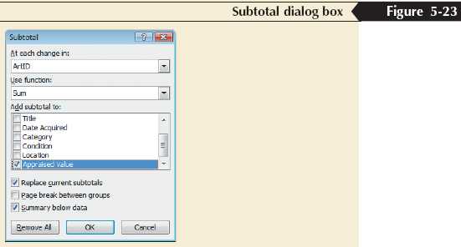
Calculating Subtotals for a Range of Data

Slide 27
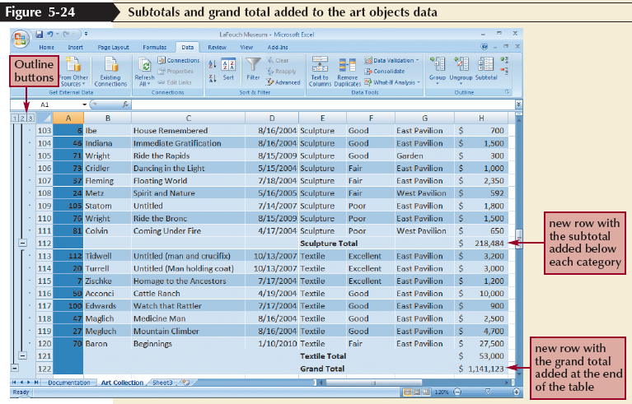
Calculating Subtotals for a Range of Data

Slide 28
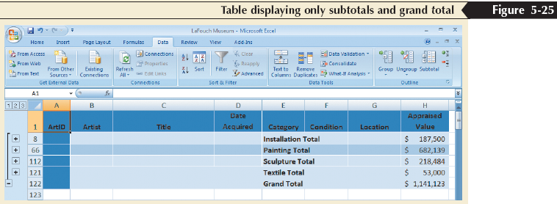
Using the Subtotal Outline View
The three Outline buttons at the top of the outline area allow you to show or hide different levels of detail in the worksheet

Slide 29
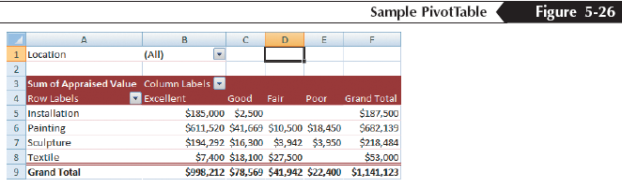
Analyzing Data with PivotTables
A PivotTable is an interactive table that enables you to group and summarize either a range of data or an Excel table into a concise, tabular format for easier reporting and analysis

Slide 30
Creating a PivotTable
Click in the Excel table or select the range of data for the PivotTable
In the Tables group on the Insert tab, click the PivotTable button
Click the Select a table or range option button and verify the reference in the Table/Range box
Click the New Worksheet option button or click the Existing worksheet option button and specify a cell
Click the OK button
Click the check boxes for the fields you want to add to the PivotTable (or drag fields to the appropriate box in the layout section)
If needed, drag fields to different boxes in the layout section

Slide 31
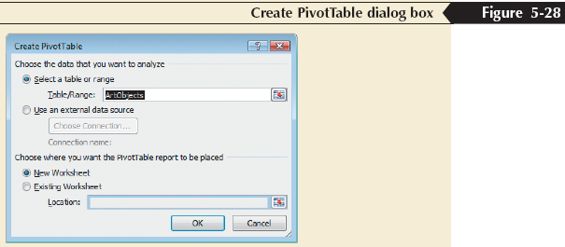
Creating a PivotTable

Slide 32
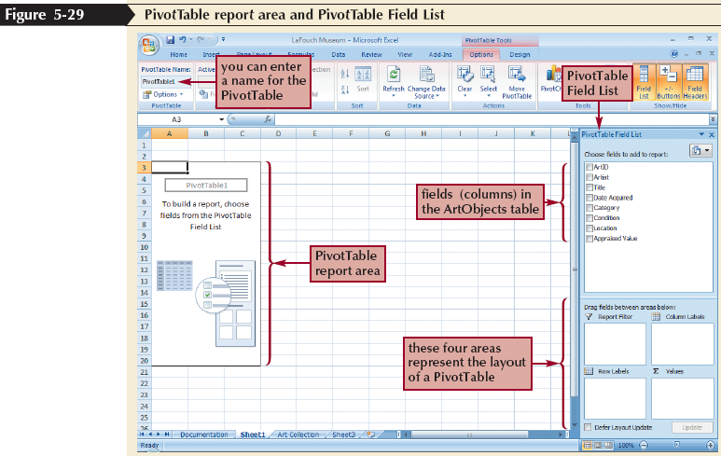
Creating a PivotTable

Slide 33
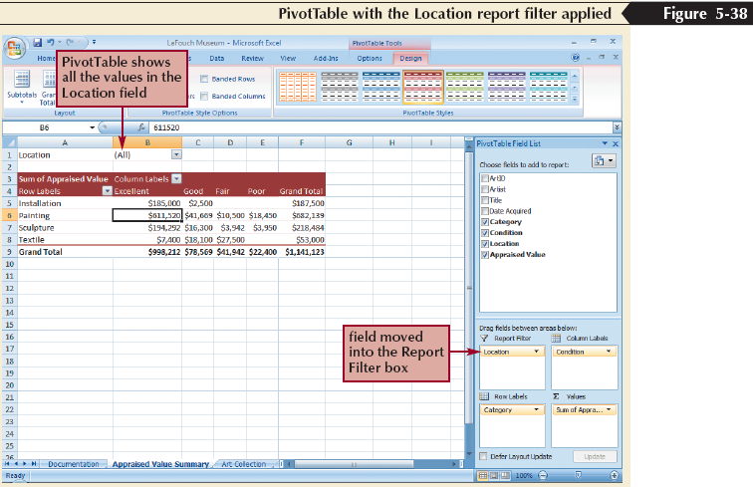
Adding a Report Filter to a PivotTable
A report filter allows you to filter the PivotTable to display summarized data for one or more field items or all field items in the Report Filter area

Slide 34
Filtering PivotTable Fields
Filtering a field lets you focus on a subset of items in that field
You can filter field items in the PivotTable by clicking the field arrow button in the PivotTable that represents the data you want to hide and then uncheck the check box for each item you want to hide

Slide 35
Refreshing a PivotTable
You cannot change the data directly in the PivotTable. Instead, you must edit the Excel table, and then refresh, or update, the PivotTable to reflect the current state of the art objects list
Click the PivotTable Tools Options tab on the Ribbon, and then, in the Data group, click the Refresh button

Slide 36
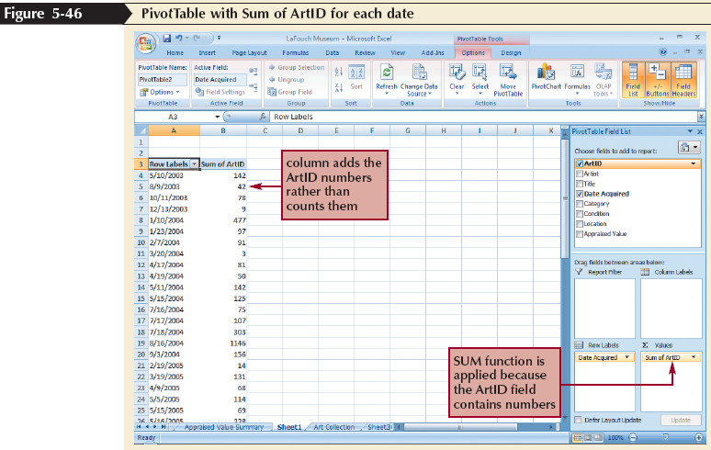
Grouping PivotTable Items
When a field contains numbers, dates, or times, you can combine items in the rows of a PivotTable and combine them into groups automatically

Slide 37
Creating a PivotChart
A PivotChart is a graphical representation of the data in a PivotTable
A PivotChart allows you to interactively add, remove, filter, and refresh data fields in the PivotChart similar to working with a PivotTable
Click any cell in the PivotTable, then, in the Tools group on the PivotTable Tools Options tab, click the PivotChart button

Slide 38
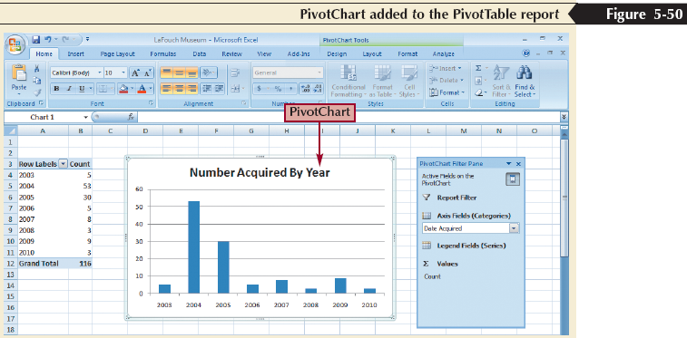
Creating a PivotChart

